Slide 1
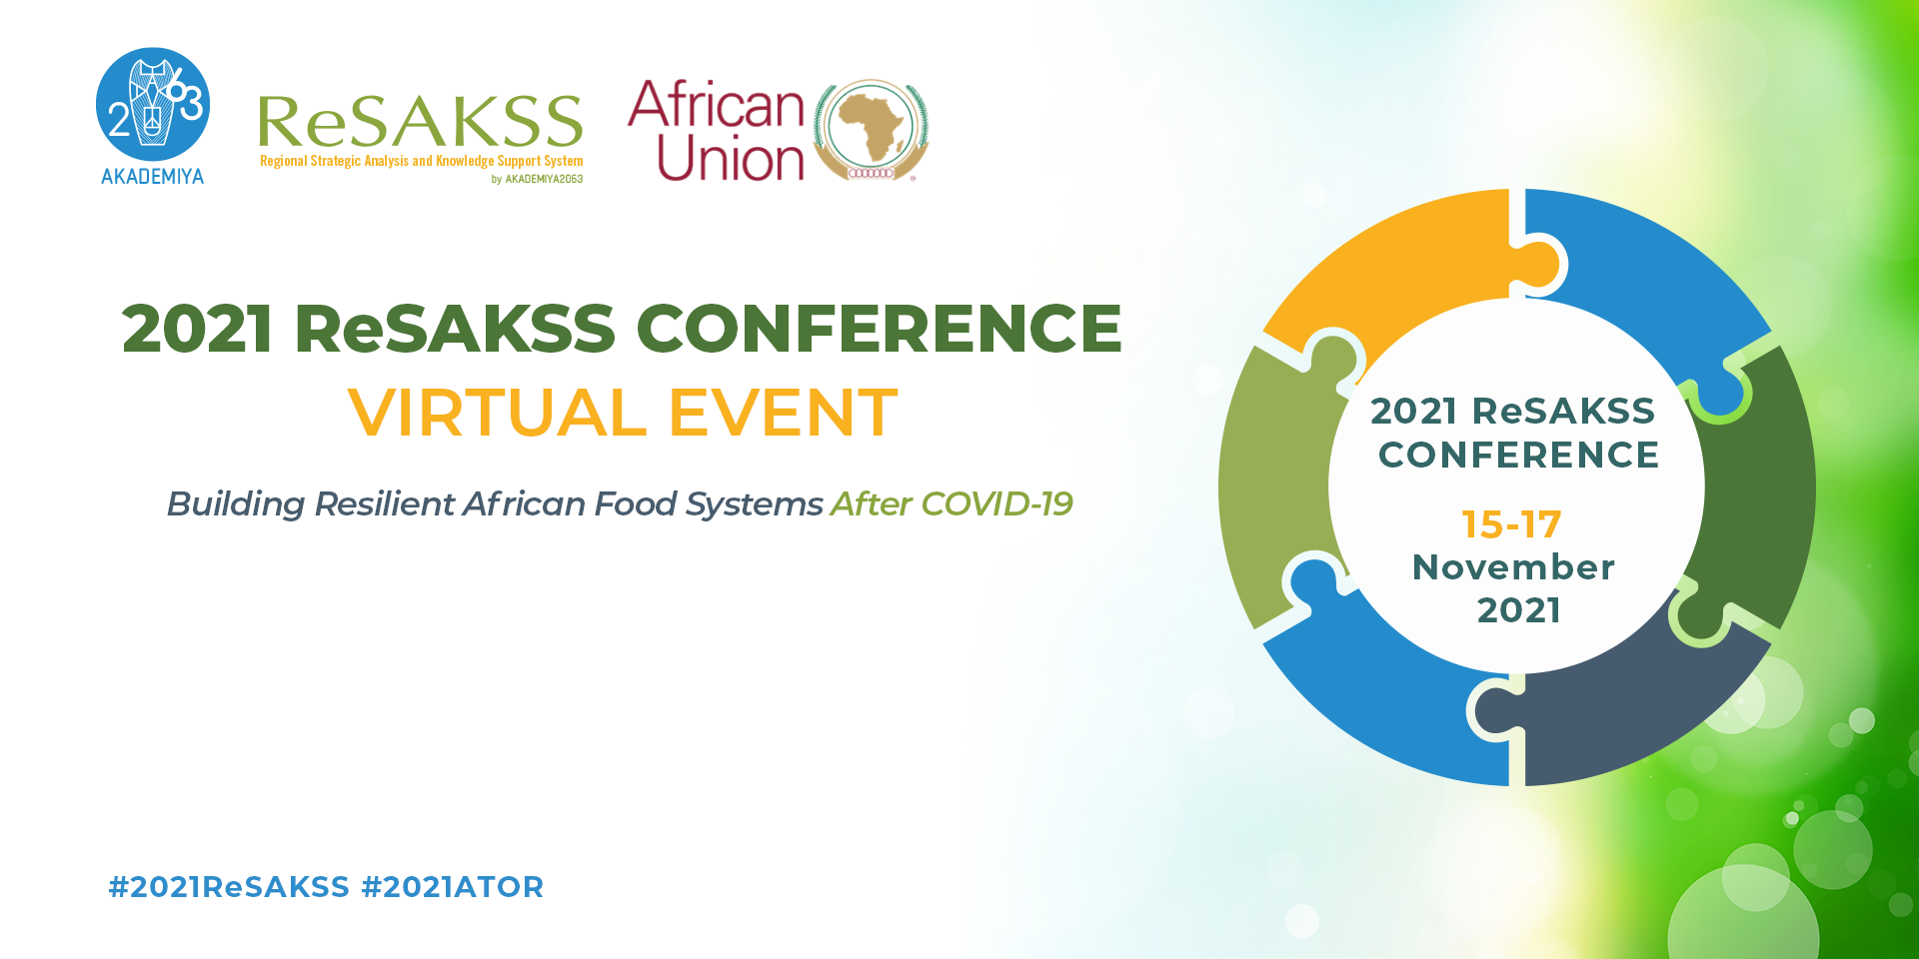
Dr. Marco d’Errico
Economist, Food and Agriculture Organization of the United Nations (FAO)

Slide 2
The Measurement of Resilience Capacities through the Integration of Macro-Level and Micro-Level Indicators
Marco D’Errico, Ellestina Jumbe, and Mark Constas

Slide 3
Introduction
Resilience measurement can now be viewed as an established body of research with 15 years of empirical evidence.
main gap: how the traditional microscale resilience perspective can be applied at a macroscale that takes structural parameters into account.
Aim: to classify countries based on a metric that integrates household resilience and level of efficiency of the national health system.
Incorporating both micro and macro dynamics of food security into the same analytical framework further contextualizes policies and grants a comprehensive approach.

Slide 4
COVID-19 and the food security context
The pandemic has stressed national healthcare systems worldwide.
Many countries seem to face a trade-off between containing the spread and cushioning the food security crisis.
Many studies report that the health shock had some devastating impacts on the global food supply and production rate.

Slide 5
Resilience Index Measurement and Analysis (RIMA)
RIMA is employed to estimate RCI, which is a measure of household resilience capacity.
Pillars: access to basic services (ABS), adaptive capacity (AC), assets (AST), and social safety nets (SSN) as well as a (FS) food security indicator.
RIMA is a well-established and widely used resilience index focusing primarily on household-level variables.
This methodology does not, however, include any indicators related to health systems.

Slide 6
Health Systems Capacity Index (HSCI)
Motive: What basic infrastructure is required for a country to respond to a health shock of the scale of COVID-19?
Figure X.1—HSCI per country and structure matrix

Slide 7
Health and Resilience Mapping
 |  | HSCI
 |  | High | Low
RCI | High | Low-risk capacity | Moderate-risk capacity
 | Low | Moderate-risk capacity | High-risk capacity
The mapping is done by employing k-means cluster analysis.
This is done where partitioning of n observations is clustered into k-clusters.

Slide 8
Identification Strategy
We estimate food security and resilience using the following model:
γ = Xβ,
Where: γ = IPC to measure food insecurity and RCI to measure the ability of households to bounce back from a shock or a stressor.
X is the design matrix, and β is a vector of parameters of resilience (ABS, AC, AST, and SSN; HSCI; Conflict; and EVI) as well as other control indicators.

Slide 9
Empirical results
 |  | HSCI
 |  | High | Low
RCI | High | Cluster 1: Ghana Tunisia | Cluster 3: Gambia Mauritania Nigeria Zimbabwe Sudan
 | Low | Cluster 2: DRC Togo | Cluster 4: Mali Guinea Bissau

Slide 10
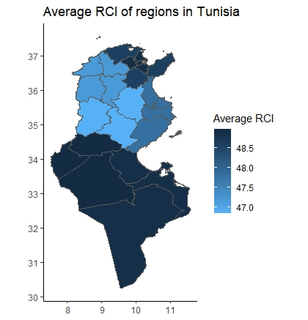
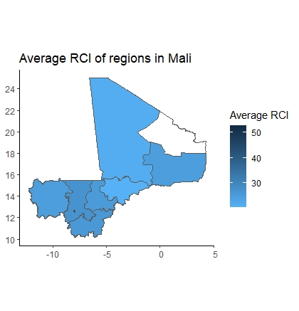
CASE STUDIES
Tunisia
Mali
*missing region= Kidal
Notes:
Tunisia: As a model country in our study, Tunisia emerges with overall high RCI and HSCI in comparison with all the other countries under study, making it low in risk in comparison with the others.
Mali: In our analysis, not only do we find Mali to be at high risk due to health indicators, but the country also exhibits low RCI across all its regions (around 20) except the capital Bamako, which has an RCI of about 52.9

Slide 11
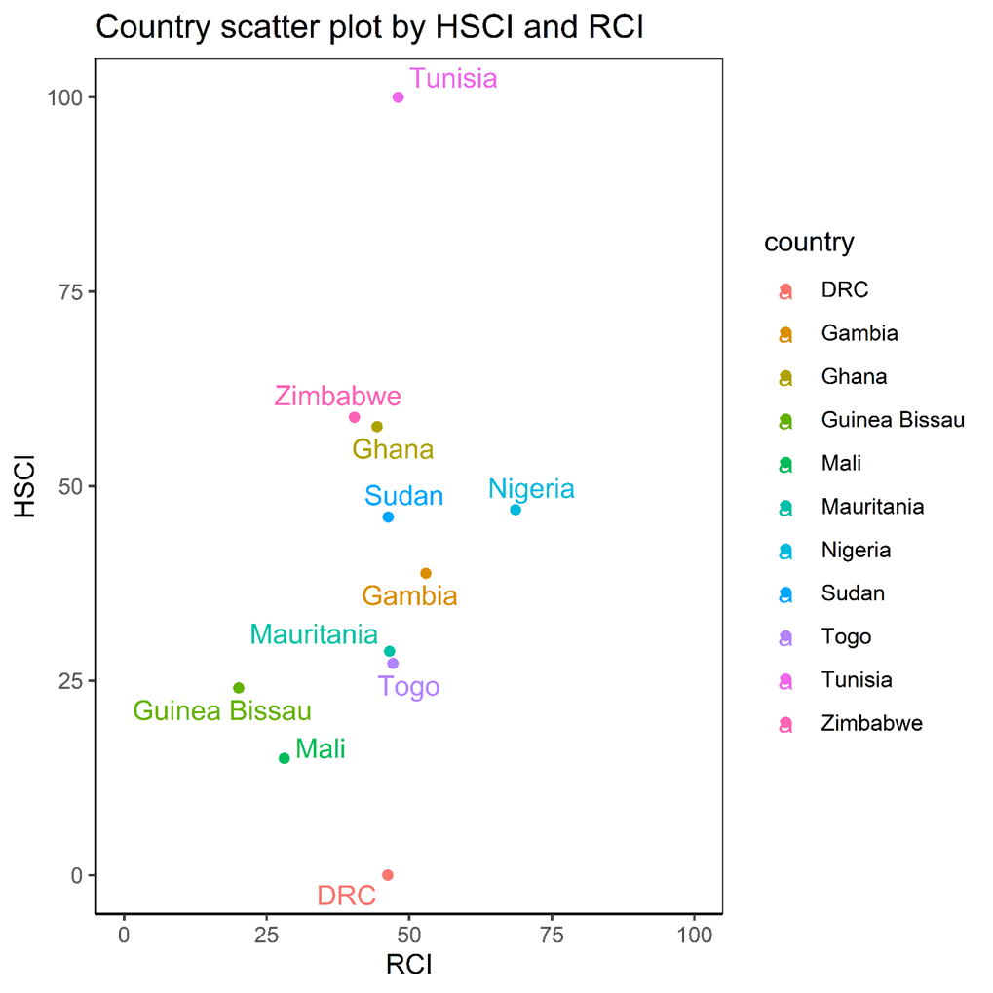
Conclusion
Our analysis show that this method may be used for ranking countries based on a generic micro-macro measure of resilience capacity to face a covariate and global shock such as COVID-19.
Incorporating health indicators in the traditional resilience measurement approach can better explain why some countries are more resilient than others.
The importance of having a resilient health system to feed into food security resilience cannot be denied.
The findings have strong policy implications, suggesting which countries have a weaker capacity to react and, consequently, are likely to pay the highest toll in terms of victims.

Slide 12
