Slide 1
Racine Ly, Ph.D.
Director, Data Management, Digital Products and Technology.
AKADEMIYA2063

Slide 2
Remote Sensing and Machine Learning for . Food Crop Production Data in Africa . Post-COVID-19
Racine Ly^{(*)}, Khadim Dia^{(*)}, Mariam Diallo^{(*)}
^{(*)}AKADEMIYA2063

Slide 3
Key Messages
The African agricultural sector is facing several threats; there is a need for good planning and tools to navigate through uncertainties.
COVID-19 showed us the importance of robust statistical systems and the need for reliable, timely, sustainable, and disaggregated data.
Conventional data gathering techniques alone are inadequate to help solve crisis that are spatially heterogeneous; Quality, massive, frequent, and disaggregated data are needed for preparedness.
Remote sensing can help reduce the data gap and machine learning allows to learn the data patterns for predictions.
The outputs produced in this chapter are available in the Africa Agriculture Watch (AAgWa) platform: www.aagwa.org.

Slide 4
Chapter motivations & outputs
The COVID-19 impacts food crop production in different ways: late reception and use of ag. inputs, labor scarcity due to mobility restriction measures.
The COVID-19 and inadequate growing conditions push countries at the blink of a major food crisis.
Crisis are time-sensitive and cannot wait for data availability and processing for action.
An indication of likely ag. production would allow planning and early interventions.
The AfCP model is built to provide stakeholders a tool for planning and decision and policymaking in food production.
The chapter uses remote sensing and machine learning to develop the Africa Crop Production (AfCP) model. The model produces predictions of ag. production and yield at the pixel level.

Slide 5
Methodology (Crop selection)
The crop selection for a country was based on its importance.
The crop importance criteria was determined by the combination of food crop production quantities and the food self-sufficiency for a country.
Two rankings: (i) 10 most produced food, (ii) ranking by self-sufficiency ratio.
The most predominant crops after the two rankings were considered.
African Regions (# countries) | Food Crops | Number of countries where the selected food crop appears in the top five
Eastern Africa (14 countries) | Maize | 8
 | Cassava | 8
 | Sugar cane | 9
Central Africa (7 countries) | Cassava | 5
Southern Africa (5 countries) | Maize | 3
Northern Africa (5 countries) | Wheat | 4
Western Africa (16 countries) | Cassava | 8
 | Rice | 9
 | Maize | 7
Table 1. List of selected food crop by African region.

Slide 6
Methodology (The AfCP model)
The model uses remote sensing data during crop growing periods.
A data processing stage produced the cleaned machine learning dataset for the predictive modeling work (cf. chapter appendix. Description of preprocessing steps).
An artificial neural network was used to build the relationship between input and response variables for each African countries.
The model was run on a test dataset for accuracy assessment (average RMSE of 0.04).
The predictions were mapped and compared with 2017 data (a year without COVID-19).
Input Parameters | Dataset ID | Spatial resolution (km) | Temporal Resolution (days) | Temporal extent (period)
NDVI | MOD13A2 | 1 | 16 | 2000 - now
LST-day | MOD11A2 | 1 | 8 | 2000 - now
Rainfall | Africa_monthly | 5.55 | 30 | 1981 – Dec 2020
Evapotranspiration | MOD16A2 | 0.5 | 8 | 2000 - now
Production | P | 10 | - | 2000, 2005, 2010, 2017
Table 2. Inputs parameters for the food crop production model with their spatial and temporal characteristics.

Slide 7
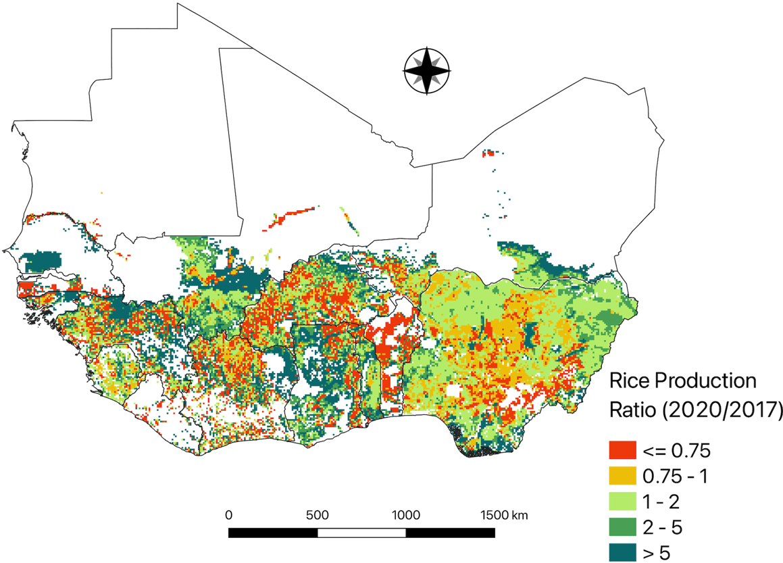
Findings (West Africa)
A rice production decrease is expected in western Africa by 12%.
Sharpest decline in Benin, Burkina Faso, and Côte d’Ivoire.
Figure 1. The 2020 predicted rice production as a share of the 2017 production for western Africa.

Slide 8
Findings (North Africa)
2017 production better than 2020 for Libya, Tunisia, Morocco, and Algeria.
Sudan and Egypt show an increase of 3.5% and 2.8% respectively.
Figure 2. The 2020 predicted wheat production as a share of the 2017 production for northern Africa.

Slide 9
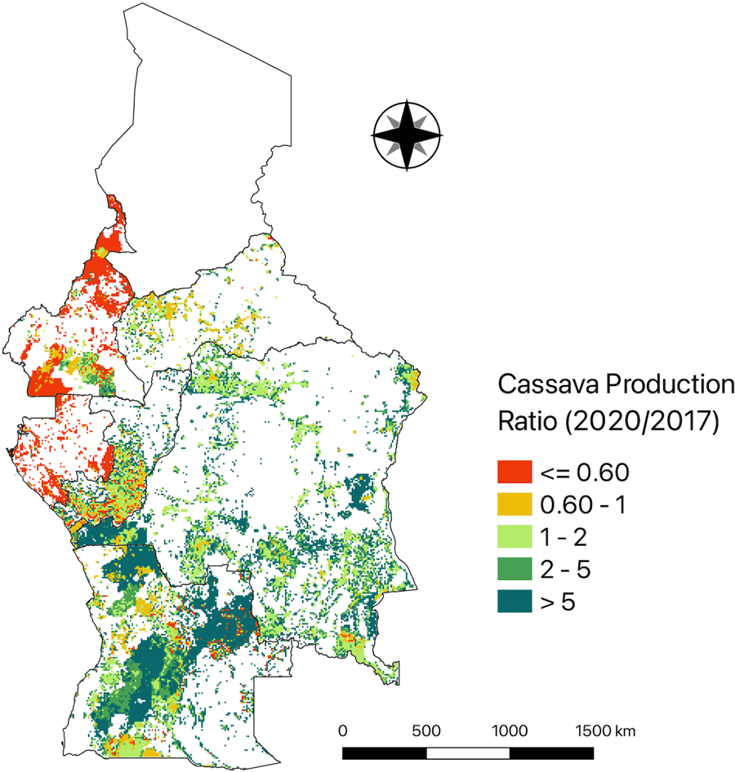
Findings (Central Africa Region)
A production of 47 million MT (2017) vs. close to 60 million MT (2020).
2017: DRC (66.6%), Angola (17.9%), Cameroon (10.2%).
2020: DRC (increase of 10%), Angola (same), Cameroon (decrease of 5.6%) compared to 2017 shares.
Figure 3. The 2020 predicted cassava production as a share of the 2017 production for central Africa region.

Slide 10
Findings (East Africa)
An overall decrease of 1.6% of maize production in east African region.
Increase in maize production Ethiopia (0.8%), Zimbabwe (13.2%), Uganda (4.6%), and Zambia (3.8%).
Figure 4. The 2020 predicted maize production as a share of the 2017 production for southern Africa.

Slide 11
Findings (South Africa)
Decrease of maize production by close to 19% in 2020 compared to 2017.
Decrease in production for South Africa (30%), Lesotho (20%), Eswatini (4.9%), and Namibia (0.7%) in 2020 compared to 2017.
Figure 5. The 2020 predicted maize production as a share of the 2017 production for southern Africa.

Slide 12
Concluding remarks
The COVID-19 came with the suggestion to build better statistical systems for better decision-making, intervention planning, and increase our level of preparedness.
Remote sensing is a good alternative / complement for collecting crop data and beyond.
Machine learning as a predictive modeling framework allow to make the invisible become blurry for navigation through uncertainties. The availability of the most likely scenarios reduces the effects of uncertainties.
Capacity building on emerging technologies need to be institutionalized; And the outputs to be produced closer to the decision-making circle.
The adoption of emerging technologies and data gathering tools could be faster.

Slide 13
